Slide 1

Unit 1:
Introduction to Software Engineering

Slide 2
Unit – 1: Introduction to Software Engineering
Introduction of software engineering:
Changing nature of the software
Legacy software
Software development myths
Generic view of Process:
Software engineering - A layered technology
Process framework
Capability Maturity Model Integration (CMMI)
Process technology
Product and process
Perspective process models:
Waterfall model
Incremental model
Evolutionary process models:
Prototyping/ Prototype model
Spiral Model
Concurrent development model

Slide 3
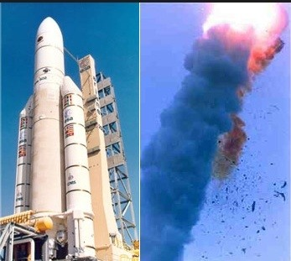
Ariane 5 - One bug, one crash
It took the European Space Agency 10 years and $7 billion to produce Ariane 5, a giant rocket capable of hurling a pair of three-ton satellites into orbit with each launch and intended to give Europe overwhelming supremacy in the commercial space business.
Issue was a small computer program trying to stuff a 64-bit number into a 16-bit space.
One bug, one crash.
Of all the careless lines of code recorded
in the history of computer science

Slide 4
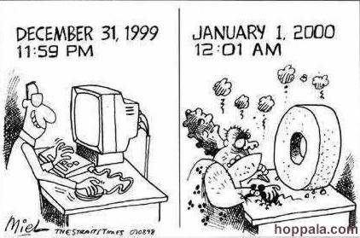
Y2K bug (millennium bug)
The Y2K bug was a computer flaw, or bug, that may have caused problems when dealing with dates beyond December 31, 1999.
The flaw, faced by computer programmers and users all over the world on January 1, 2000, is also known as the "millennium bug..
Computer engineers used a two-digit code for the year. Instead of a date reading 1970, it read 70.
As the year 2000 approached,
computer programmers realized that computers might not interpret
00 as 2000, but as 1900

Slide 5
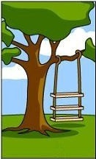
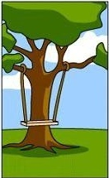
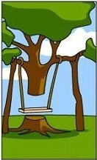

Why to Study Software Engineering?
Software Development Life Cycle without Software Engineering
1
2
3
4
How the Customer
Explains Requirement
How the Project Leader
understand it
How the System Analyst
design it
How the Programmer Works
on it

Slide 6

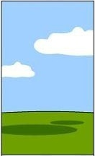

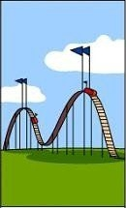
Why to Study Software Engineering?
Software Development Life Cycle without Software Engineering
5
6
7
8
How the Business
Consultant describe it
How the Project
was
documented
What
Operations Installed
How the Customer
was
billed

Slide 7

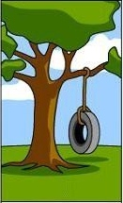
Why to Study Software Engineering?
Software Development Life Cycle
without Software Engineering
Software development
Process needs to be
engineered to avoid
the communication gape
& to meet the actual
requirement of customer
within stipulated budget
& time
9
10
How it
was supported
What the
customer
really needed

Slide 8
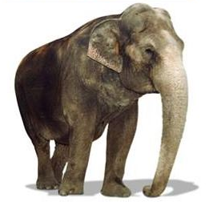

SDLC without Software Engineering
Customer Requirement
Solution
Have one trunk
Have four legs
Should carry load both passenger & cargo
Black in color
Should be herbivorous
Have one trunk
Have four legs
Should carry load both passenger & cargo
Black in color
Should be herbivorous
Our value added
Also gives milk

Slide 9
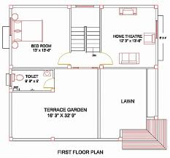
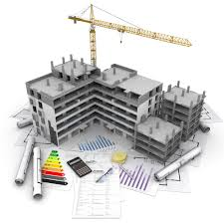
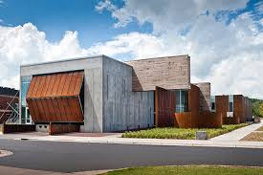

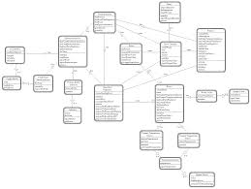
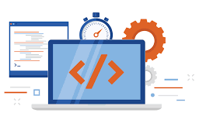
Software Engineering
Engineering
Software Engineering
Design
Build
Product

Slide 10
Software Engineering
Software engineering is the establishment and use of sound engineering principles in order to obtain economically software that is reliable and works efficiently in real machines.
Software Engineering is the science and art of building (designing and writing programs) a software systems that are:
on time
on budget
with acceptable performance
with correct operation

Slide 11
Software Engineering Cont.
Software Engineering is a layered technology
Quality
Main principle of Software Engineering is Quality Focus.
An engineering approach must have a focus on quality.
Total Quality Management (TQM), Six Sigma, ISO 9001, ISO 9000-3, CAPABILITY MATURITY MODEL (CMM), CMMI & similar approaches encourages a continuous process improvement culture
Process layer
It is a foundation of Software Engineering
It is the glue the holds the technology layers
It defines a framework with activities for effective delivery of software engineering technology

Slide 12
Software Engineering Cont.
Method
It provides technical how-to’s for building software
It encompasses many tasks including communication, requirement analysis, design modeling, program construction, testing and support
Tools
Computer‐aided software engineering (CASE) is the scientific application of a set of tools and methods to a software system which is meant to result in high‐quality, defect‐free, and maintainable software products.
CASE tools automate many of the activities involved in various life cycle phases.

Slide 13
Changing nature of the software
Characteristics of Software
Software is developed or engineered
It is not manufactured like hardware
Manufacturing phase can introduce quality problem that are nonexistent (or easily corrected) for software
Both requires construction of “product” but approaches are different
Software doesn’t “wear-out”
Infant
mortality
“Wear out”
Failure Rate
Time
Fig: Bathtub curve of hardware failure

Slide 14
Characteristics of Software cont.
Change
Increate failure rate due to side effect
Actual Curve
Failure Rate
Idealized Curve
Time
Fig: Software failure curve
Slowly, the minimum failure rate level begins to rise – Software is deteriorating due to change.
Although the industry is moving toward component based construction, most software continues to be custom built

Slide 15
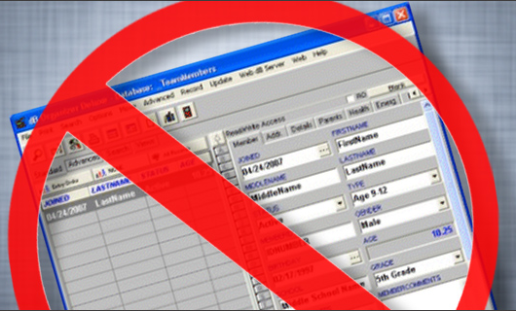
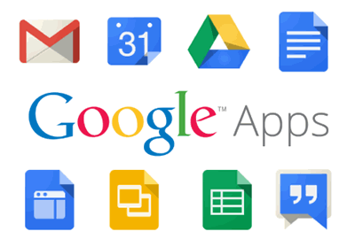
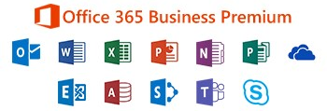
Software is dead…..!
The old School view of Software
You buy it
You own it &
It’s your job to manage it
That is coming to an end
Because of web 2.0 & extensive computing power, there is a different generation of software
It is delivered via Internet
It looks exactly like it’s residing on each user’s computing device
Actually it reside on far away server

Slide 16



What is Software?
Software is
Computer program that when executed provide desired features, function & performance
Data Structure that enable programs to easily manipulate information
Descriptive information in both hard and soft copy that describes the operation and use of programs
+
+
Computer
Program
Data
Structure
Documents
Soft & Hard

Slide 17
Legacy Software
State-of-the art software
Why must it change?
Software must be adapted to meet the needs of new computing environments or technology.
Software must be enhanced to implement new business requirements.
Software must be extended to make it interoperable with other more modern systems or databases.
Software must be re-architected to make it viable within a network environment.

Slide 18
Software Development Myths
Affect managers, customers (and other non-technical stakeholders) and practitioners.
Are believable because they often have elements of truth, but …
Invariably lead to bad decisions,
therefore …
Insist on reality as you navigate your way through software engineering

Slide 19

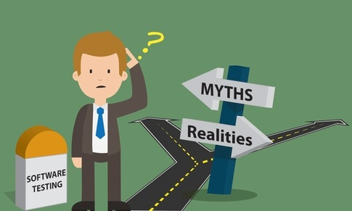


Software Myths
Management Myths
Customer Myths
“Misleading Attitudes that cause serious problem” are myths.
Practitioner's (Developer) Myths

Slide 20

Management myth - 1 & 2
We have standards and procedures to build a system, which is enough.
We have the newest computers and development tools.
Reality
Reality
Are software practitioners aware of standard’s existence?
Does it reflect modern software engineering practice?
Is it complete?
Is it streamlined to improve time to delivery while still maintaining a focus on quality?
In many cases, the answer to all of these questions is "no.“
It takes much more than the latest model computers to do high-quality software development.
Computer-aided software engineering (CASE) tools are more important than hardware.

Slide 21
Management myth - 3 & 4
We can add more programmers and can catch up the schedule.
I outsourced the development activity, now I can relax and can wait for the final working product.
Reality
Reality
Software development is not a mechanistic process like manufacturing.
In the words of Fred Brooks : "adding people to a late software project makes it later."
People who were working must spend time educating the newcomers.
People can be added but only in a planned and well-coordinated manner.
If an organization does not understand how to manage and control software projects internally, it will invariably struggle when it outsources software projects.

Slide 22

Customer myth - 1 & 2
A general statement of objectives (requirements) is sufficient to start a development.
Requirement Changes can be easily accommodated because software is very flexible.
Reality
Reality
Comprehensive (detailed) statements of requirements is not always possible, an ambiguous (unclear) “statement of objectives” can lead to disaster.
Unambiguous (clear) requirements can be gathered only through effective and continuous communication between customer and developer.
It is true that software requirements change, but the impact of change varies with the time at which it is introduced.
When requirements changes are requested early the cost impact is relatively small.

Slide 23

Practitioner's (Developer) myth – 1 & 2
Once we write the program, our job is done.
I can’t access quality until it is running.
Reality
Reality
One of the most effective software quality assurance mechanisms can be applied from the beginning of a project - the technical review.
Software reviews are more effective “quality filter” than testing for finding software defects.
Experts say "the sooner you begin 'writing code', the longer it will take you to get done."
Industry data indicates that 60 to 80% effort expended on software will be after it is delivered to the customer for the first time.

Slide 24
Practitioner's (Developer) myth – 3 & 4
Working program is the only deliverable work product.
Software engineering is about unnecessary documentation.
Reality
Reality
A working program is only one part of a software configuration.
A variety of work products (e.g., models, documents, plans) provide a foundation for successful engineering and, more important, guidance for software support.
Software engineering is not about creating documents. It is about creating a quality product.
Better quality leads to reduced rework. And reduced rework results in faster delivery times.

Slide 25
Generic View of Process
The Process , What is it?
A series of predictable steps.
A roadmap that helps create a timely, high quality.
Who does it?
Software Engineers and their managers adopt it their needs.
Users play a role in the process of defining, building and testing.

Slide 26
Generic View of Process
Why is it important?
It provides stability, control, and organization to an activity
Uncontrolled activity becomes quite chaotic
Modern software engineering approach must be “agile"
Demand only those activities, controls and documentation that are appropriate for the project team and the product.
What are the steps?
The process that you adopt depends on the software that you’re building.

Slide 27
Software Process
A process is a collection of activities, actions and tasks that are performed when some work product is to be created
A process is not a rigid prescription for how to build the software, rather it is adaptable approach that enables the people doing the work to pick and choose the appropriate set of work actions and tasks
An activity try to achieve a broad objective (e.g., communication with stakeholders)
An activity is applied regardless of the application domain, size of the project, complexity of the effort, or degree of accuracy with which software engineering is to be applied.
An action (e.g., architectural design) encompasses a set of tasks that produce a major work product (e.g., an architectural design model).
A task focuses on a small, but well-defined objective (e.g., conducting a unit test) that produces a noticeable outcome.
Each of these activities, actions & tasks reside within a framework or model

Slide 28
Software Process
Figure in the next slide represents “The Software Process”
Each framework activity is populated by set of software engineering actions
Each software engineering action is defined by a task set that identifies work to be completed, product to be produced, quality assurance points & milestones to indicate progress
The purpose of software process is
to deliver software in timely manner and
within sufficient quality to satisfy those
Who has given proposal for software development and
Those who will use software

Slide 29
Software Process Framework
Process framework
Umbrella activities
framework activity #1
Software Engineering action #1.1
Software Process
Task Sets
Work tasks
Work products
Quality assurance points
… …
Software Engineering action #1.k
Task Sets
Work tasks
Work products
Quality assurance points
… …
framework activity #n

Slide 30

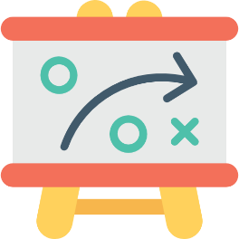
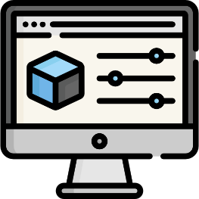

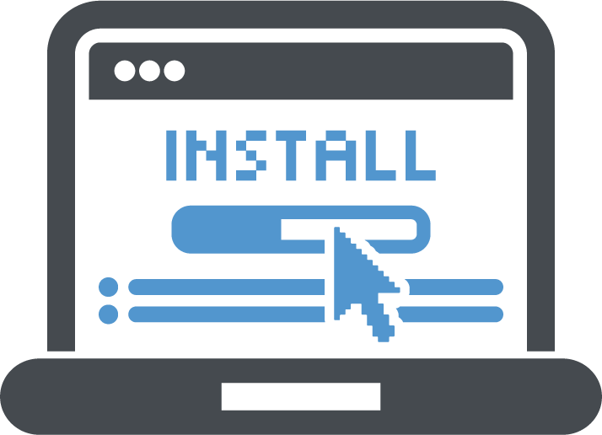
Process Framework Activities
Communication
Communication with Customers / stockholders to understand project requirements for defining software features
Planning
Software Project Plan which defines workflow that is to follow.
It describes technical task, risks, resources, product to be produced & work schedule
Modeling
Creating models to understand requirements and shows design of software to achieve requirements
Construction
Code
Generation
(manual or automated)
&
Testing
(to uncover errors in the code)
Deployment
Deliver Software to Customer
Collect feedback from customer based on evaluation
Software Support

Slide 31
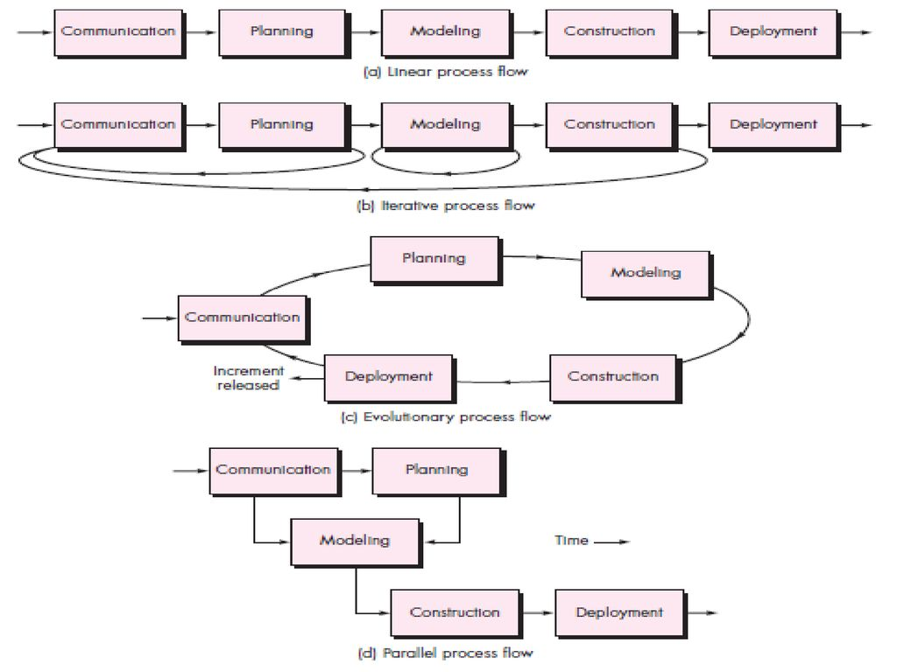
Types of Process Flow

Slide 32

Umbrella Activities
Umbrella activities applied throughout the software project & help a software team to manage and control progress, quality, change & risks
Umbrella activities are those which keep running in the background throughout the software development
It establish a skeleton architecture for software engineering work.

Slide 33
Umbrella Activities Cont.
Software project Tracking & Control
Risk Management
Software quality assurance
Technical Reviews
Measurement
Reusability Management
Software Configuration Management
Work product preparation and production

Slide 34
Umbrella Activities Cont.
Software project tracking and control: allows the software team to assess progress against the project plan and take any necessary action to maintain the schedule.
Risk management: assesses (evaluates) risks that may affect the outcome of the project or the quality of the product.
Software quality assurance: defines and conducts the activities required to ensure software quality.
Technical reviews: assesses software engineering work products in an effort to uncover and remove errors before they are propagated to the next activity.
Measurement: defines and collects process, project and product measures that assist the team in delivering software that meets stakeholders’ needs.

Slide 35
Umbrella Activities Cont.
Software configuration management: it manages the effects of change throughout the software process.
Reusability management: it defines criteria for work product reuse (including software components) and establishes mechanisms to achieve reusable components.
Work product preparation and production: it encompasses (includes) the activities required to create work products such as models, documents, logs, forms and lists.

Slide 36
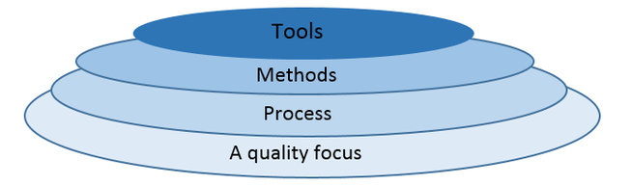
Software Engineering Layered Technology
Software Engineering Tools allows automation of activities which helps to perform systematic activities. A system for the support of software development, called computer-aided software engineering (CASE). Examples: Testing Tools, Bug/Issue Tracking Tools etc…
It provides technical how-to’s for building software, it encompasses many tasks including communication, requirement analysis, design modeling, program construction, testing and support
It is a foundation of Software Engineering, It is the glue the holds the technology layers, It defines a framework activities
Defines continuous process improvement principles

Slide 37
Software Engineering Layered Approach Cont.
Quality
Main principle of Software Engineering is Quality Focus.
An engineering approach must have a focus on quality.
Total Quality Management (TQM), Six Sigma, ISO 9001, ISO 9000-3, CAPABILITY MATURITY MODEL (CMM), CMMI & similar approaches encourages a continuous process improvement culture
Process Layer
It is a foundation of Software Engineering, It is the glue the holds the technology layers together and enables logical and timely development of computer software.
It defines a framework with activities for effective delivery of software engineering technology
It establish the context in which technical methods are applied, work products (models, documents, data, reports, forms, etc.) are produced, milestones are established, quality is ensured, and change is properly managed.

Slide 38
Software Engineering Layered Approach Cont.
Method
It provides technical how-to’s for building software
It encompasses many tasks including communication, requirement analysis, design modeling, program construction, testing and support
Tools
Software engineering tools provide automated or semiautomated support for the process and the methods
Computer‐aided software engineering (CASE) is the scientific application of a set of tools and methods to a software system which is meant to result in high‐quality, defect‐free, and maintainable software products.
CASE tools automate many of the activities involved in various life cycle phases.

Slide 39
Capability Maturity Model Integration
Capability Maturity Model Integration (CMMI) is a successor of CMM and is a more evolved model that incorporates best components of individual disciplines of CMM like Software CMM, Systems Engineering CMM, People CMM, etc. Since CMM is a reference model of matured practices in a specific discipline, so it becomes difficult to integrate these disciplines as per the requirements. This is why CMMI is used as it allows the integration of multiple disciplines as and when needed.
Objectives of CMMI :
Fulfilling customer needs and expectations.
Value creation for investors/stockholders.
Market growth is increased.
Improved quality of products and services.
Enhanced reputation in Industry.

Slide 40
Capability Maturity Model Integration(cont…)
CMMI Model – Maturity Levels :
In CMMI with staged representation, there are five maturity levels described as follows :
Maturity level 1 : Initial
processes are poorly managed or controlled.
unpredictable outcomes of processes involved.
ad hoc and chaotic approach used.
No KPAs (Key Process Areas) defined.
Lowest quality and highest risk.
Maturity level 2 : Managed
requirements are managed.
processes are planned and controlled.
projects are managed and implemented according to their documented plans.
This risk involved is lower than Initial level, but still exists.
Quality is better than Initial level.

Slide 41
Capability Maturity Model Integration(cont…)
Maturity level 3 : Defined
processes are well characterized and described using standards, proper procedures, and methods, tools, etc.
Medium quality and medium risk involved.
Focus is process standardization.
Maturity level 4 : Quantitatively managed
quantitative objectives for process performance and quality are set.
quantitative objectives are based on customer requirements, organization needs, etc.
process performance measures are analyzed quantitatively.
higher quality of processes is achieved.
lower risk

Slide 42
Capability Maturity Model Integration(cont…)
Maturity level 5 : Optimizing
continuous improvement in processes and their performance.
improvement has to be both incremental and innovative.
highest quality of processes.
lowest risk in processes and their performance.

Slide 43
Process Technology
Process technology tools allow a software organization to build an automated model of the common process framework, task sets, umbrella activities
Once an acceptable process has been created, other process technology tools can be used to allocate, monitor, and even control all software engineering tasks.

Slide 44
Product and Process
Product: In the context of software engineering, product includes any software manufactured based on the customer’s request. This can be a problem solving software or computer based system. It can also be said that this is the result of a project.
Process: Process is a set of sequence steps that have to be followed to create a project. The main purpose of a process is to improve the quality of the project. The process serves as a template that can be used through the creation of its examples and is used to direct the project.

Slide 45
Software Process Models
The process model is the abstract representation of process.
Also known as Software development life cycle (SDLC) or Application development life cycle Models
Process models prescribe a distinct set of activities, actions, tasks and milestones (deliverables) required to engineer high quality software.
Process models are not perfect, but provide roadmap for software engineering work.
Software models provide stability, control and organization to a process that if not managed can easily get out of control.
Software process models are adapted (adjusted) to meet the needs of software engineers and managers for a specific project.

Slide 46
SDLC Phases
Communication
SDLC
Deployment
Planning
Software
Development
Life
Cycle
Construction
Modelling

Slide 47
Different Process Models
Waterfall Model (Linear Sequential Model)
Incremental Process Model
Prototyping Model
The Spiral Model
Rapid Application Development Model

Slide 48
The Waterfall Model cont.
Requirement Gathering and analysis
Design
Coding
Testing
Maintenance

Slide 49
The Waterfall Model cont.
In requirement gathering and analysis phase the basic requirement of the system must be understood by software engineer, who is also called analyst. The information domain , function, behavioral requirements of the system are understood. All these requirements are then well documented and discussed further with the customer, for reviewing.
In design is an intermediate step between requirement analysis and coding.
Data structure
Software Architecture
Interface representation
Algorithmic details
The requirement are translated in some easy to represent from using which coding can be effectively and efficiently.

Slide 50
The Waterfall Model cont.
Coding is a step in which design is translated into machine –readable form. If design is done in sufficient detail then coding can be done effectively. Programs are crated in this phase
Testing begins when coding is done. While performing testing the major focus is on logical internals of the software. The testing ensures execution of all the paths, functional behaviors. The purpose of testing is to uncover errors, fix the bugs and meet the customer requirements.
Maintenance is the longest life cycle phase. When the system is installed and put in practical use then error may get introduced, correcting such errors and putting it in use Is the major purpose of maintenance activity. Similarly, enhancing system services as new requirements are discovered is again maintenance of the system.

Slide 51
The Waterfall Model cont.
When requirements for a problems are well understood then this model is used in which work flow from communication to deployment is linear
This Model also called as the Classic life cycle or linear sequential model.
When to use ?
Requirements are very well known, clear and fixed
Product definition is stable
Technology is understood
There are no ambiguous (unclear) requirements
Ample (sufficient) resources with required expertise are available freely
The project is short

Slide 52
The Waterfall Model cont.
Advantages
Simple to implement and manage
Drawbacks
Unable to accommodate changes at later stages, that is required in most of the cases.
Working version is not available during development. Which can lead the development with major mistakes.
Deadlock can occur due to delay in any step.
Not suitable for large projects.

Slide 53
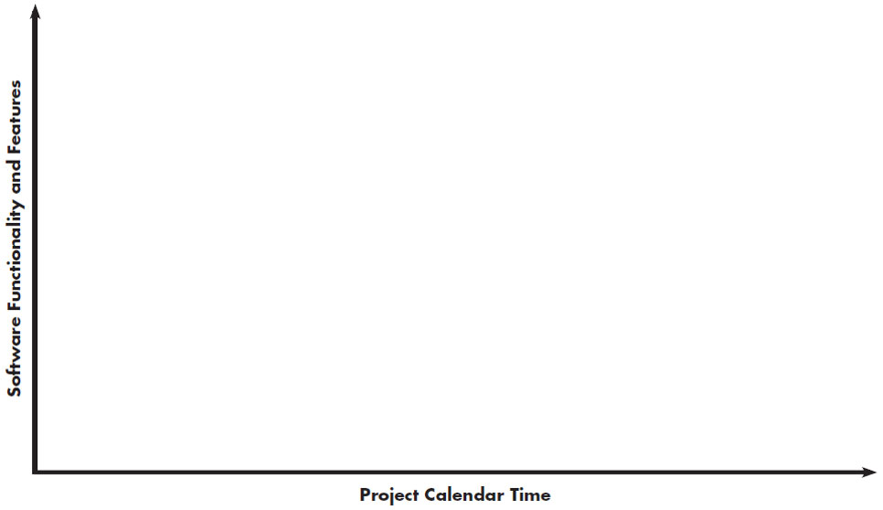
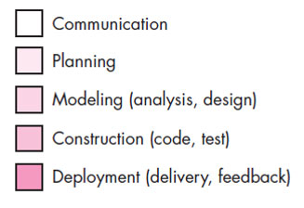
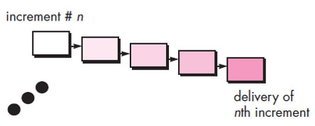
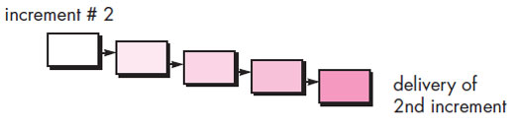
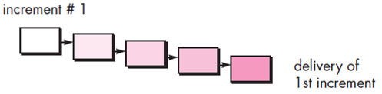
Incremental Process Model

Slide 54
Incremental Process Model cont.
The incremental model combines elements of linear and parallel process flows.
This model applies linear sequence in a iterative manner.
Initially core working product is delivered.
Each linear sequence produces deliverable “increments” of the software.
For example, word-processing software developed using the incremental model
It might deliver basic file management, editing and document production functions in the first increment
more sophisticated editing in the second increment;
spelling and grammar checking in the third increment; and
advanced page layout capability in the fourth increment.

Slide 55
Incremental Process Model cont.
When to Use ?
When the requirements of the complete system are clearly defined and understood but staffing is unavailable for a complete implementation by the business deadline.
Advantages
Generates working software quickly and early during the software life cycle.
It is easier to test and debug during a smaller iteration.
Customer can respond to each built.
Lowers initial delivery cost.
Easier to manage risk because risky pieces are identified and handled during iteration.

Slide 56
Rapid Application Development Model
Team - 1
Modeling
Construction
Communication
Integration
Delivery
Feedback
Team - 2
Planning
Modeling
Deployment
Construction
Team - 3
Modeling
Component Reuse
Automatic Code Generation
Testing
Business Modeling
Data Modeling
Process Modeling
Construction

Slide 57
RAD Model Cont.
It is also know as RAD Model
It is a type of incremental model in which; components or functions are developed in parallel.
Rapid development is achieved by component based construction
This can quickly give the customer something to see and use and to provide feedback.
Communication
This phase is used to understand business problem.
Planning
Multiple software teams work in parallel on different systems/modules.

Slide 58
RAD Model Cont.
Modeling
Business Modeling: Information flow among the business.
Ex. What kind of information drives (moves)?
Who is going to generate information?
From where information comes and goes?
Data Modeling: Information refine into set of data objects that are needed to support business.
Process Modeling: Data object transforms to information flow necessary to implement business.
Construction
It highlighting the use of pre-existing software component.
Deployment
Deliver to customer basis on subsequent iteration.

Slide 59
RAD Model Cont.
When to Use ?
There is a need to create a system that can be modularized in 2-3 months of time.
High availability of designers and budget for modeling along with the cost of automated code generating tools.
Resources with high business knowledge are available.
Advantages
Reduced development time.
Increases reusability of components.
Quick initial reviews occur.
Encourages customer feedback.
Integration from very beginning solves a lot of integration issues.

Slide 60
RAD Model Cont.
Drawback
For large but scalable projects, RAD requires sufficient human resources.
Projects fail if developers and customers are not committed in a much shortened time-frame.
Problematic if system can not be modularized.
Not appropriate when technical risks are high (heavy use of new technology).

Slide 61
Difference Between RAD and Incremental Model
Sr.No. | RAD Model | Incremental Model
1. | Rad model is a software development model where by the components or functions are developed in parallel as if they were mini projects. | Incremental Model is a software development model where the product is, analyzed, designed, implemented and tested incrementally until the product is finished.
2. | Rad model requirements and early stage planning is not necessary. | In incremental model requirements and early stage planning is necessary.
3. | RAD model is used between large and small project. | Incremental model can’t handle large project.
4. | There is low amount risk in RAD model. | There is also low amount risk in incremental model.
5. | In RAD model small team size is required. | In incremental model large team is not required.
6. | Flexibility to change in rad model is Easy. | Flexibility to change in incremental model is Easy.
7. | In rad model overlapping of phases is possible. | In incremental model overlapping of phases is possible.
8. | Testing is done in rad model after completion of coding. | Testing is done in incremental model after every iteration of phase.
9. | Returning to previous stage/phase in rad model is possible. | Returning to previous stage/phase in incremental model is possible.
10. | Cost of rad model is also Low. | Cost of incremental model is also Low.

Slide 62
Evolutionary Process Models
When a set of core product or system requirements is well understood but the details of product or system extensions have yet to be defined.
In this situation there is a need of process model which specially designed to accommodate product that evolve with time.
Evolutionary Process Models are specially meant for that which produce an increasingly more complete version of the software with each iteration.
Evolutionary Models are iterative.
Evolutionary models are
Prototyping Model
Spiral Model
Concurrent Development Model

Slide 63
Prototyping model
Prototyping model is appropriate when
Customers have general objectives of software but do not have detailed requirements for functions & features.
Developers are not sure about efficiency of an algorithm & technical feasibilities.
It serves as a mechanism for identifying software requirements.
Prototype can be serve as “the first system”.
Both stakeholders and software engineers like prototyping model
Users get feel for the actual system
Developers get to build something immediately

Slide 64
Prototyping model cont.
Deployment & Feedback
Communication
Construction of Prototype
Quick Plan
Modeling Quick Design

Slide 65
Prototyping model cont.
It works as follow
Communicate with stockholders & define objective of Software
Identify requirements & design quick plan
Model a quick design (focuses on visible part of software)
Construct Prototype & deploy
Stakeholders evaluate this prototype and provides feedback
Iteration occurs and prototype is tuned based on feedback
Problem Areas
Customer demand that “a few fixes” be applied to make the prototype a working product, due to that software quality suffers as a result
Developer often makes implementation in order to get a prototype working quickly; without considering other factors in mind like OS, Programming language, etc.

Slide 66
Prototyping model cont.
Advantages
Users are actively involved in the development
Since in this methodology a working model of the system is provided, the users get a better understanding of the system being developed
Errors can be detected much earlier

Slide 67
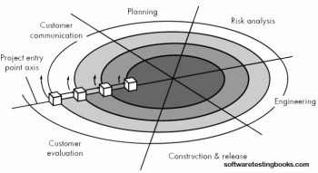
The Spiral Model

Slide 68
The Spiral Model cont.
The Spiral model is an evolutionary process model that couples iterative nature of prototyping with the controlled and systematic aspects of waterfall model
It provides the potential for rapid development.
Software is developed in a series of evolutionary releases.
Early iteration release might be prototype but later iterations provides more complete version of software.
It is divided into framework activities. Each activity represent one segment of the spiral
Each pass through the planning region results in adjustments to
the project plan
Cost & schedule based on feedback

Slide 69
The Spiral Model cont.
Customer communication: it is suggested to establish customer communication
Planning: All planning activities are carried out in order to define resources time line and other project related activities.
Risk Analysis: The tasks required to calculate technical and management risks are carried out.
Engineering: In this task region, tasks required to build one or more representations of applications are carried out.
Construct and release: All necessary tasks required to construct, test, install the application are conducted. Some tasks that are required to provide user support are also carried out in this task region.
Customer evaluation: Customer's feedback is obtained and based on customer evaluation required tasks are performed and impended at installation stage.

Slide 70
The Spiral Model cont.
When to use Spiral Model?
For development of large scale / high-risk projects.
When costs and risk evaluation is important.
Users are unsure of their needs.
Requirements are complex.
New product line.
Significant (considerable) changes are expected.
Advantages
High amount of risk analysis hence, avoidance of Risk is enhanced.
Strong approval and documentation control.
Additional functionality can be added at a later date.
Software is produced early in the Software Life Cycle.

Slide 71
The Spiral Model cont.
Disadvantages
Can be a costly model to use.
Risk analysis requires highly specific expertise.
Project’s success is highly dependent on the risk analysis phase.
Doesn’t work well for smaller projects.

Slide 72
WIN-WIN Spiral Model
The spiral model suggests a framework activity that addresses customer communication. The objective of this activity is to elicit project requirements from the customer. In an ideal context, the developer simply asks the customer what is required and the customer provides sufficient detail to proceed. Unfortunately, this rarely happens. In reality, the customer and the developer enter nto a process of negotiation, where the customer may be asked to balance functionality, performance, and other product or system characteristics against cost and time to market.
The best negotiations strive for a “win-win” result. That is, the customer wins by getting the system or product that satisfies the majority of the customer’s needs and the developer wins by working to realistic and achievable budgets and deadlines.
Customer’s WIN means: Obtaining the system that satisfies most of the needs.
Developer’s WIN means: Getting the work done with realistic and achievable budges and deadlines.

Slide 73
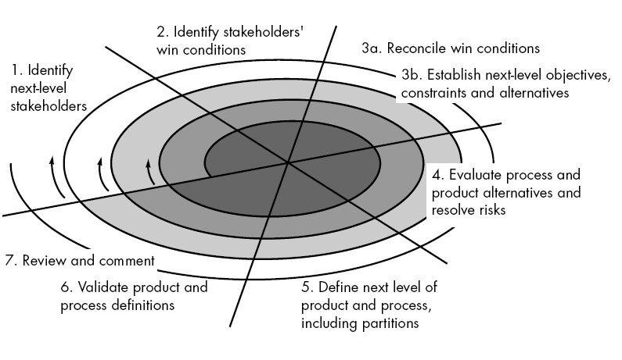
WIN-WIN Spiral Model Cont.

Slide 74
WIN-WIN Spiral Model Cont.
Boehm’s WINWIN spiral model defines a set of negotiation activities at the beginning of each pass around the spiral. Rather than a single customer communication activity, the following activities are defined:
Identification of the system or subsystem’s key “stakeholders.”
Determination of the stakeholders’ “win conditions.”
Negotiation of the stakeholders’ striving for win condition. With the concerned software project team reconcile for WIN-WIN result then determine next level objectives, constraints and alternatives.
Evaluate process and product. Analyze and resolve the risks
Define next level of product and process
Validate process and product definitions.
Take a review of product and give necessary comments on it.

Slide 75
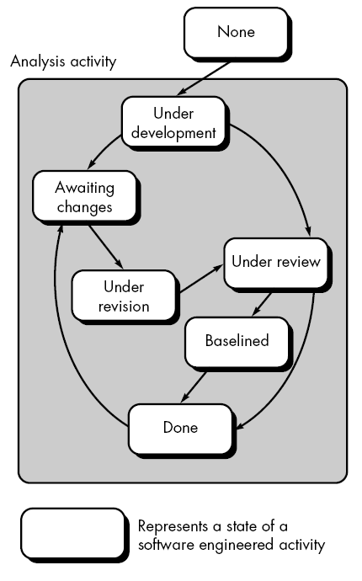
Concurrent Development

Slide 76
Concurrent Development Cont.
This model is also called as concurrent engineering model. In this model the framework activities are represented as series of tasks. For example the modelling activity can performed in various states. These states contain various activities or task.
For instance : modelling activity can be initially in under development state. Then when certain processes or activities are going on it might be in awaiting changes state. Some reviews or revisions might be carried out on the developed or partially developed software. Hence under review or under revision might be some states.
Finally the software product goes in done state. Sometimes some inconsistencies in analysis model may trigger some changes in the existing product. Then for implementing those changes product has to undergo awaiting changes state.

Slide 77
Concurrent Development Cont.
Advantages
All types of software development can be done using concurrent development model.
This model provides accurate picture of current state of project.
Each activity or task can be carried out concurrently. Hence this model is an efficient process model.

Slide 78





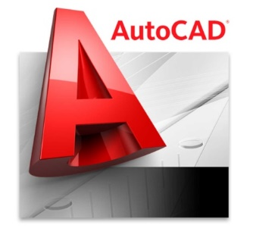





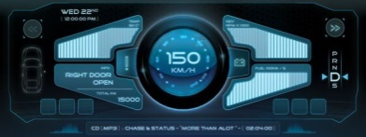

Software Application Domains
System Software
Point of Sale,
Customized
Software
Artificial intelligence Software
Application
Software
Software Application Domains
Web Application
Engineering / Scientific Software
Product line Software
Embedded Software

